Slide 1

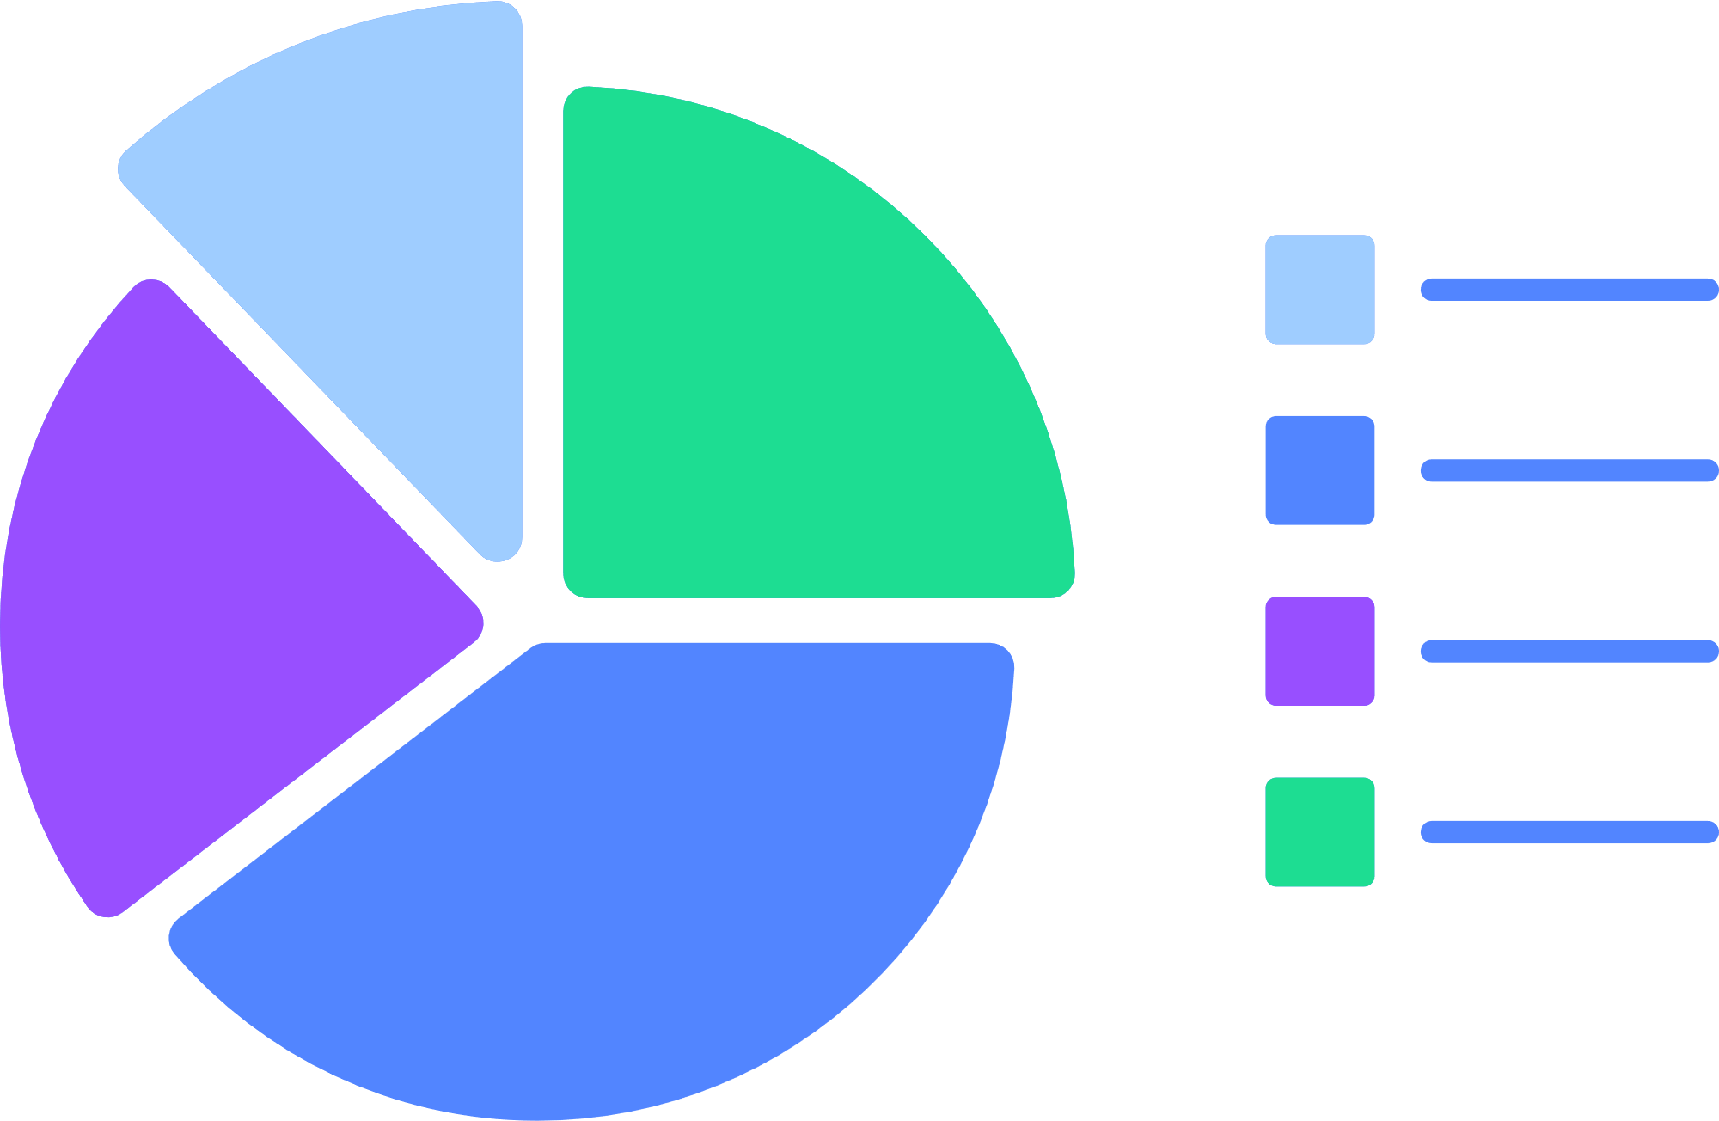

DB Wiz - AI Powered Data Visualiser
Explore how to organize and present data

Slide 2




Table of contents
Introduction
Literature Survey
Problem Definition
Objectives
Market Survey
Tech Stack
Proposed system model
References

Slide 3
Introduction
DB Wiz : A data visualizer
Our project, DB Wiz, is a data visualization app with AI integration. It aims to simplify the process of creating visualizations for SQL databases.
We also provide AI assistance for Natural Language Queries, and a user friendly GUI, to lower the skill threshold for using relational databases.
This presentation outlines our roadmap to develop this app, and backs the usefulness and validity of this idea.

Slide 4

All Papers cited focus on using data to uncover valuable insights and they also help us to explore AI techniques to create and analyze data visualizations.
A stark increase in the number of AI related papers about visualizations can be seen after 2018, primarily due to the advent of AI in recent years it’s surge in popularity.
Papers talk about different ways AI could assist in this domain, like translating queries across languages, providing approximate visualizations using AI to improve performance at the cost of accuracy, etc.
A stark focus is on Improving existing visualizations with AI techniques.
Literature Survey

Slide 5


Problem Definition
Project Title: An AI powered data visualizer with support for natural language Database queries and AI assisted visualization tools.
Visualizing data in a relational database may require many intermediate steps (like exporting that data into excel) and may be slow and cumbersome without dedicated tools.
There are usually certain skill thresholds to using such software and such software may not be very accessible (ex. high pricing).
AI is an emerging field and may have applications in this regard, which is also a topic being researched on.

Slide 6
Making an easy to use no-code SQL database visualizer with GUI.
Integrating AI into the process to make user experience as well as development process simpler (The exact uses are mentioned in the model section).
Providing chatbot like NLP features for user to run simple SQL queries in english
Creating a minimal and free alternative to apps like Tableau or powerBI for students and individuals.
Acting as proof of concept that AI integration can help in this regard, and that this application of AI is only to become more relevant as AI agents improve at such a rapid pace.
Objectives

Slide 7
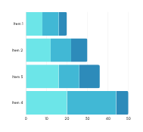
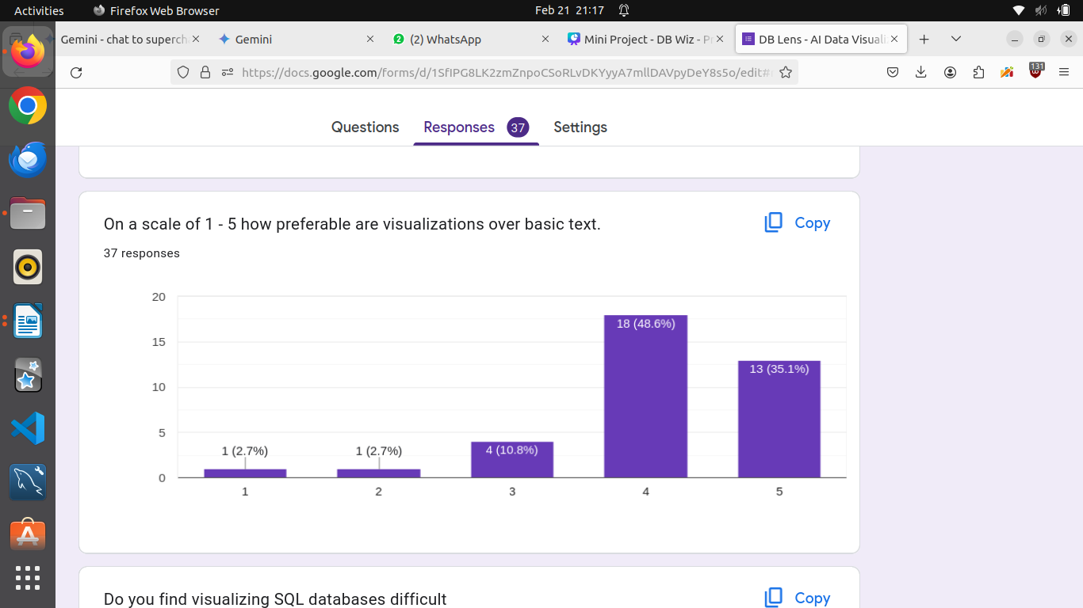
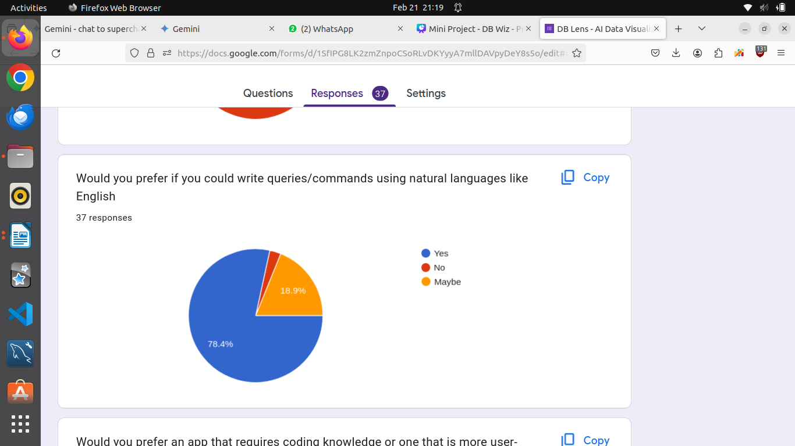
Market Survey
Market survey inferences:
Most of the students prefered visualization over basic text.
Most of students feel at ease when writing queries in natural language

Slide 8

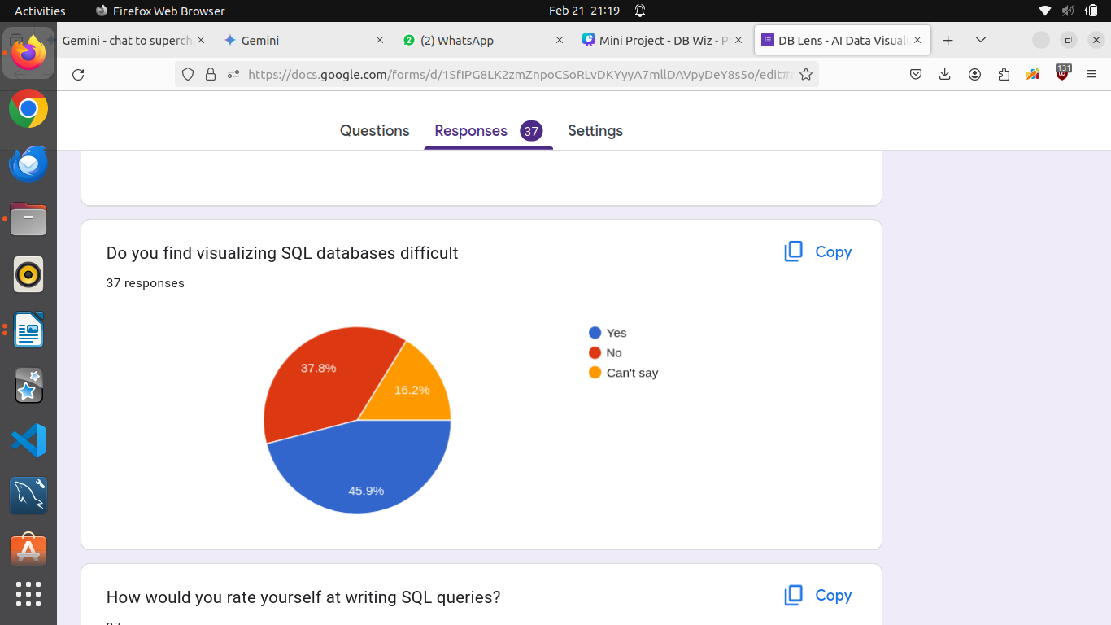
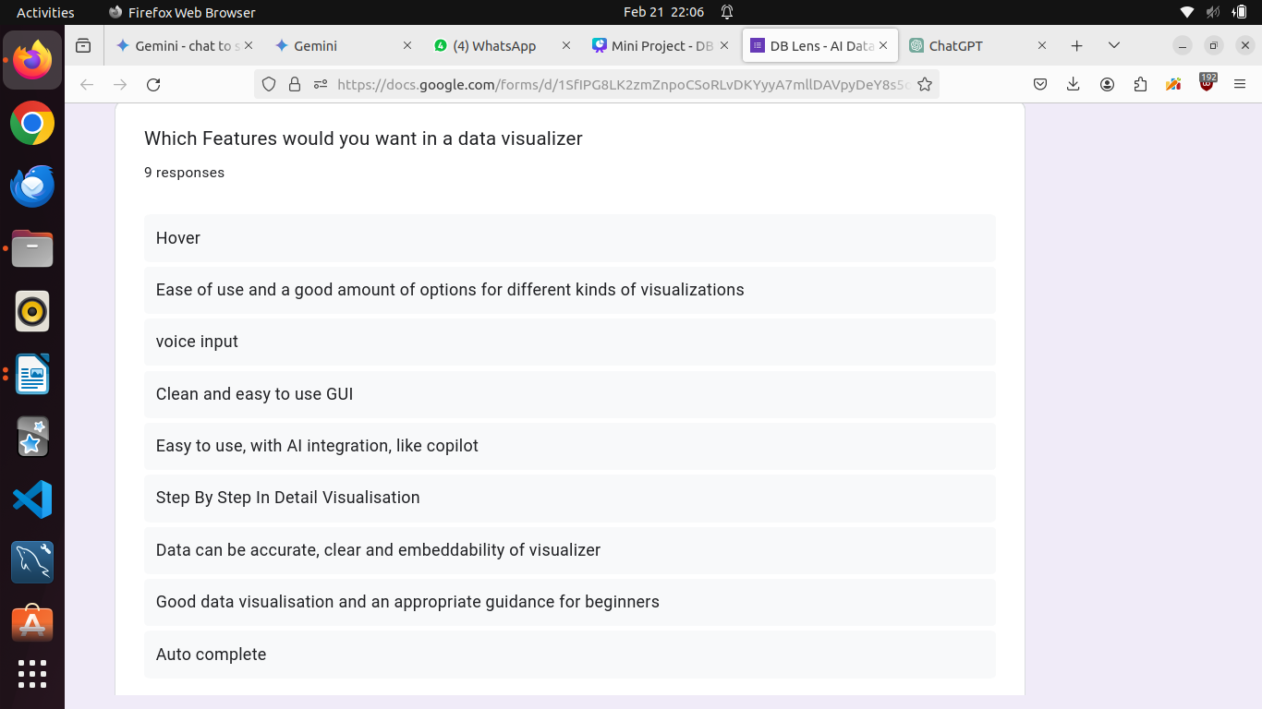
Many students found visualizing SQL databases difficult
DBWiz provides many features requested by students

Slide 9



Tech Stack
Frontend
React JS was the optimal
choice for the frontend
framework of the application
as it has an abundance of
libraries for making the
development process easier.
It is also preferable to port on
desktop and mobile devices using
tools like electron and react native
React

Slide 10

Tech Stack
Frontend
Material UI was the optimal
choice for the UI library of the
application as it is the most
modular unlike bare-bones CSS
and still customizable unlike options
like Bootstrap
Material UI

Slide 11

Tech Stack
Backend
As we are making an app which is
powered by React JS in the frontend
it was sensible to create the backend
in something with the same language
as Javascript.
Hence, Node JS was the perfect
contender for the job.
It has optimal speed and
development ease .
Node JS

Slide 12

Tech Stack
Backend
For creating https requests over the
network and handling routes and
middleware in Node JS, express js
is by far the fastest and most
unopiniated.
Express JS

Slide 13


Tech Stack
Authentication and Security
For secure login and sign up for
the users.
OAuth
Non - relational database for user data
For storing user data and saved
databases and dashboards.
MongoDB

Slide 14


Tech Stack
APIs
Powerful language translation tools to break down communication
barriers and convert Natural
Language to SQL queries
OpenAI API
Panel's reactive design lets your
visualizations and tools respond
dynamically to user input. To convert
data to graphs and charts
Panel graphing
API

Slide 15
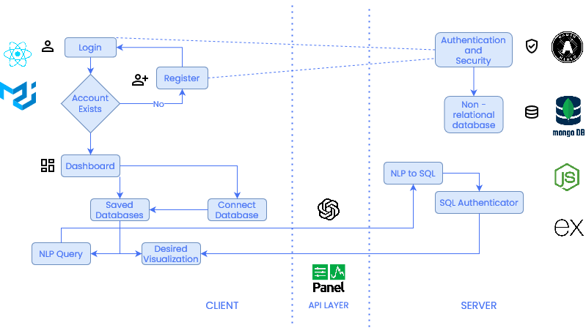
Proposed System model: block diagram

Slide 16
Proposed system model
We would first generate the schema of the ingested database through pre written logic, then the user would choose the data from the tables for which to make the charts for.
For this process, we would use Generative AI to write prompts and retrieve data from the database as per the user’s selections. The selections can demand pretty complex queries to be written which would be difficult to pre-program, so AI could help us in this case.
The schema generated by us would be passed on to the AI agent, which would then generate queries to retrieve data as the user chooses. A query validation process should also be incorporated so that the AI agent is prompted with the error message from the SQL server if one is generated, and a new prompt is requested.
After the data required by the user is read from the database, the visualizations would be then made using the PANEL api in python.
The app would also have a chatbot like feature wherein the user can write natural language prompts to the AI to retrieve data from the database in question.
Though this may not be the best way to process data as of now, as AI agents get better with time, and they have been showing an astonishingly high rate of growth, the queries written by the AI would only get more accurate and the response time would only decrease. So this project also acts as a proof of concept in this regard.
This application of AI also makes development easier as now the developer no longer needs to handle all complex queries which would be required.

Slide 17

References
Qin, X., Luo, Y., Tang, N. et al. Making data visualization more efficient and effective: a survey. The VLDB Journal 29, 93–117 (2020). https://doi.org/10.1007/s00778-019-00588-3
A. Wu et al., "AI4VIS: Survey on Artificial Intelligence Approaches for Data Visualization," in IEEE Transactions on Visualization and Computer Graphics, vol. 28, no. 12, pp. 5049-5070, 1 Dec. 2022, doi: 10.1109/TVCG.2021.3099002
Fan, Ying. "Dynamic Interaction and Visualization Design of Database Information Based on Artificial Intelligence." IJITSA vol.16, no.3 2023: pp.1-13. http://doi.org/10.4018/IJITSA.324749

Slide 18




Mentor
Prof. Pramod Bide
Thank You
Group 1
Shubhan Singh
Swaroop Vaze
Vikas Singh

